Slide 1


Lab#04 Introduction to Microsoft Office (part-2 Microsoft Power point)
Name: Maaz Habib
Registration No. : 273
Class Section: C
Submitted To: Eng. Abdullah Hamid

Slide 2
Apple company
Today we are going to talk about iPhone brand, It is a company that not only produces mobiles, but also laptops and other gadgets. It's expensive but people do prefer them as they can be trusted in every aspects, like security, designs, usage etc. There are many disadvantages in it but also a lot of advantages also that people are attracted towards it easily. As they say "Best thing always come in with expensive prices".
Samsung company
Samsung and Apple are always in competition and there user are also in competition, but mostly people use Samsung for their low and cheap prices, As compare to Apple, Samsung produces a phone with low power according to the budget plans and the best product in that budget. Samsung are also having high end devices like apple, That are in comparison to apple. Samsung are good in battery life and price but there security isn't as good as apple.

Slide 3
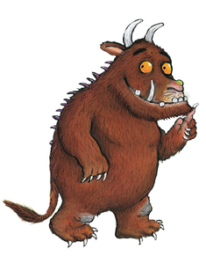
The Gruffalo
The Gruffalo has two large, curved horns at the top of his head. He has a bright orange eyes and a slimy, black tongue. The Gruffalo has an enormous, poisonous wart on the end of his wet nose. Running all down his back are sharped pointy prickles. His claws are as sharp as razors and his teeth are blunt and brittle. HIs fur feels as soft as cotton wool but it is matted and tangled. He has knobby knees and turned out toes. His feet are gigantic and he stomps through the forest whilst swishing his long busy tail. The animals are scared of him because he is so terrifyingly large.

Slide 4

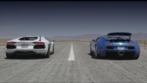

Slide 5
Thank you

